Slide 1
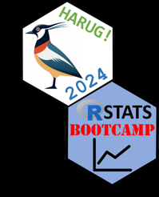
Puzzle Days, Code Club
RE: Harper @ Telford Ed Harris

Slide 2

Rubber ducking
To describe your problems to a rubber-duck or other inanimate object. Common in data science, the act of describing your problem simply may help you discover a solution.

Slide 3

Tell it to the duck.

Slide 4

Data Science Puzzle Days
<or>
How I stopped worrying and learned to love data

Slide 5
Data Science puzzle day
- An event where participants learn to solve programming challenges or puzzles
- Designed to test and improve problem-solving and team work
- Participants work on various problems, often with increasing difficulty

Slide 6


Data Science Code Club
<or>
How I stopped worrying and learned to love code

Slide 7
Coding club
- a group where people meet to learn, practice, and discuss programming together
- Work on projects, share knowledge, and improve coding skills in a collaborative environment

